Slide 1
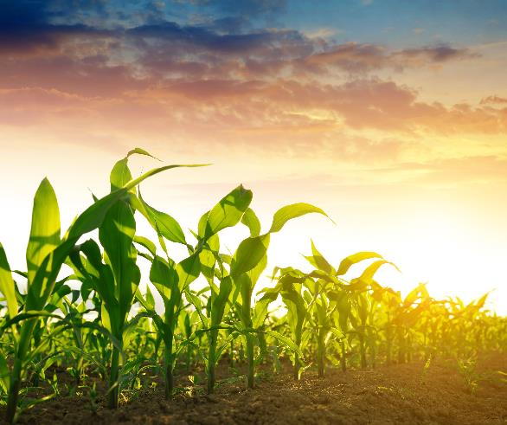
Resource Concerns in South Dakota
Jessica Michalski, State Resource Conservationist
SD NRCS

Slide 2
Resource Concerns SWAPAE + H
Soil
Water
Air
Plants
Animals
Energy
Human

Slide 3
Resource Concerns SWAPAE + H
18 Resource Concern Categories
50 Resource Concerns
90 Resource Concern Components
Some Resource Concerns only have one component, some have multiple

Slide 4
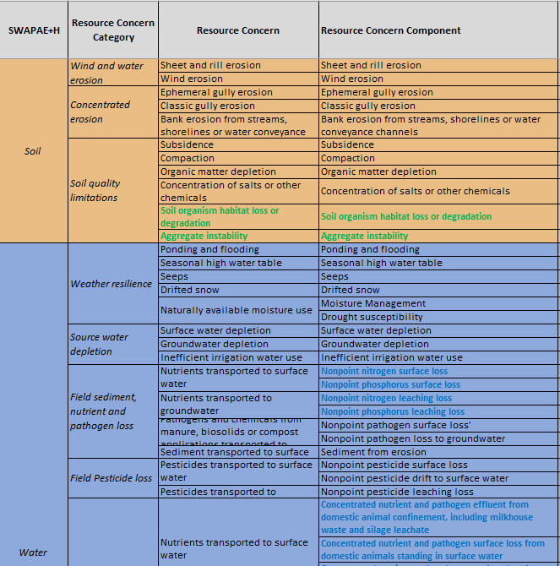

Slide 5
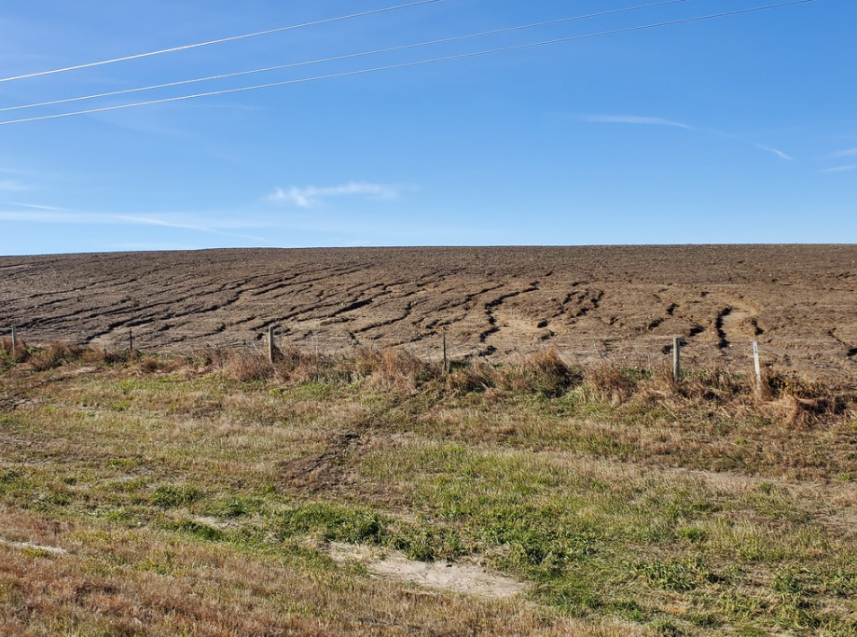
Soil Category=Wind & Water Erosion
Sheet and Rill Erosion-Detachment and transport of soil particles caused by rainfall, melting snow, or irrigation.
Notes:
Sheet & Rill Erosion-
Indicators-Changes in soil horizon thickness, soil deposition in fields and water courses, and decreased organic matter
Causes-
• Bare or unprotected soil
• Soil disturbing activities such as tillage and construction site activities
• Long and steep slopes
• Significant and intense rainfall or irrigation events when residue cover is at a minimum
• Decreased infiltration by compaction or poor soil structure
Solutions
• Reduce tillage using residue and tillage management
• Conservation crop rotations
• Cover crops
• Contour farming and contour buffer strips
• Stripcropping
• Terraces
• Prescribed grazing

Slide 6
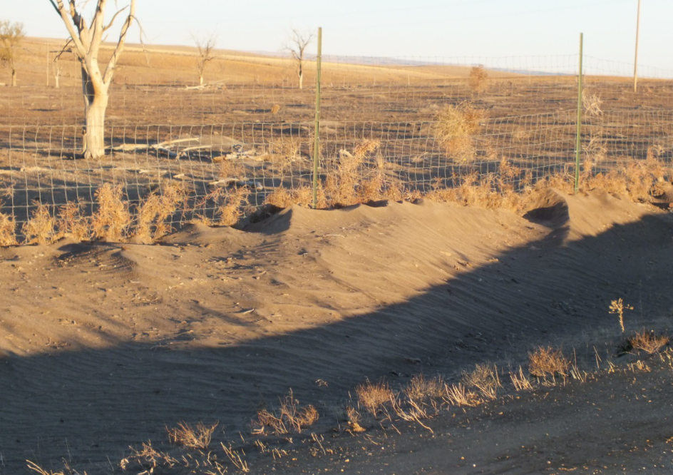
Wind Erosion-Detachment and transport of soil particles caused by wind.
Soil Category=Wind & Water Erosion
Notes:
Wind Erosion-
Indicators-Changes in soil horizon thickness, soil deposition in fields and water, and decreased organic matter
Causes-
• Bare or unprotected soil
• Long slopes
• Intense wind events when residue cover is at a minimum
• Decreased infiltration by compaction or poor soil structure
Solutions:
• Residue and tillage management
• Conservation crop rotations
• Cover crops
• Stripcropping
• Windbreaks
• Permanent vegetative cover
• Herbaceous wind barrier

Slide 7
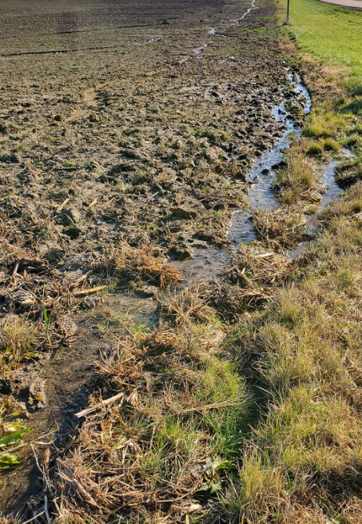
Soil Category=Concentrated Erosion
Ephemeral gully erosion-Soil erosion that results in small gullies in the same flow area that can be obscured by tillage.
Notes:
Ephemeral Gully Erosion-
Indicators-Branching or tree-like pattern of rills in areas of concentrated flow
Causes:
• Bare or unprotected soil
• Soil disturbing activities such as tillage
• Decreased infiltration by compaction or poor soil structure
Solutions:
• Reduce tillage using residue and tillage management
• Conservation crop rotations
• Cover crops
• Terraces
• Grassed waterways
• Permanent vegetative cover
• Water and sediment control basins

Slide 8
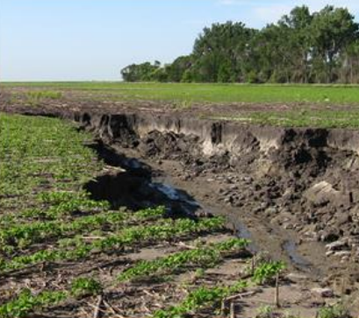
Soil Category=Concentrated Erosion
Classic gully erosion-Gullies created by runoff that can enlarge a channel progressively by head cutting and/or lateral widening.
Notes:
Classic Gully Erosion-
Indicators-Branching or tree-like pattern of rills, gullies, headcuts
Causes:
• Bare or unprotected soil
• Poor soil structure
• Reduced infiltration
• Excess runoff
• Inadequate outlet for water
• Unusually large storm event
Solutions:
• Reduce tillage using residue and tillage management
• Cover crops
• Grassed or lined waterways
• Grade stabilization structure
• Water and sediment control basin

Slide 9
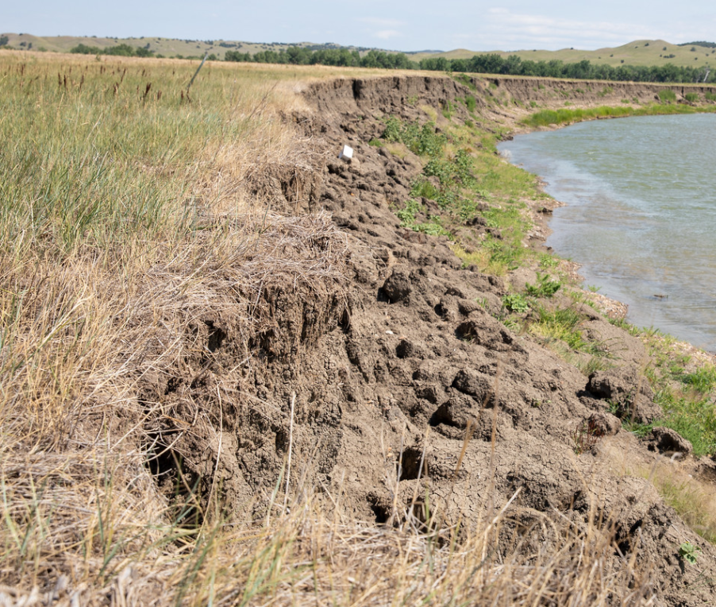
Soil Category=Concentrated Erosion
Bank erosion from streams, shorelines or water conveyance channels-Erosion resulting from poor land management practices, storm events, wave action, rain, ice, wind, runoff, loss of vegetation, hydrologic dynamics, stream isolation from floodplains, and/or other disturbed/altered geomorphological processes.
Notes:
Bank Erosion-
Indicators-Eroding Banks, degrading streambed, and manipulated stream channels
Causes:
• Increased runoff due to land use changes in the watershed
• Eroding or unstable streambanks
• Exposed tree roots along banks
• Large runoff events
• Degraded riparian areas
• Uncontrolled livestock access
Solutions:
• Bank armor and protection (rock or other approved material)
• Soil bioengineering practices
• Instream structures
• Native material revetments
• Riparian areas with native or locally adapted vegetation
• Control livestock access to the water bodies

Slide 10
Soil Category =Soil Quality Limitations
Subsidence-Loss of volume and depth of organic soils due to oxidation caused by above normal microbial activity resulting from excessive water drainage, soil disturbance, or extended drought. This excludes karst sinkholes and issues, or depressions caused by underground activities. This resource concern is only applicable when the soil is a histosol.
Notes:
Subsidence is not a resource concern in SD as there are no histosols.

Slide 11
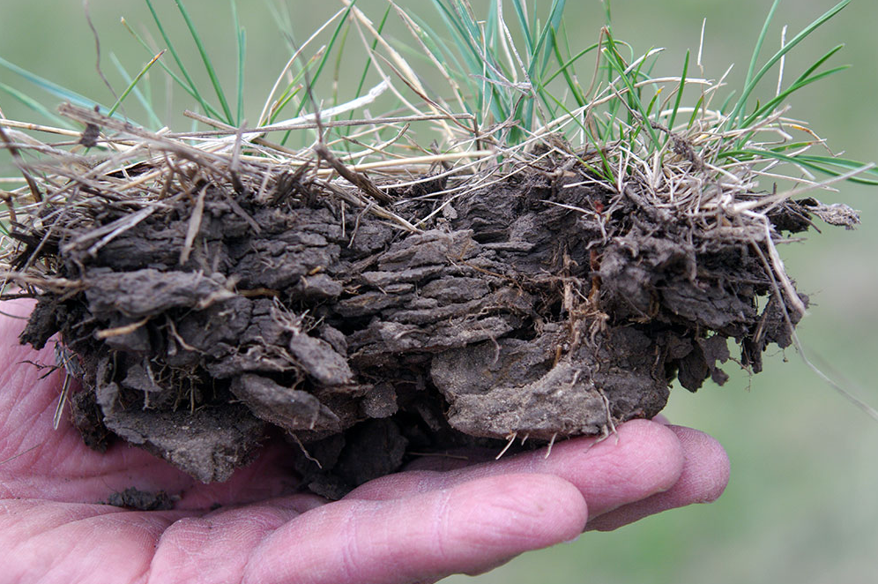
Soil Category =Soil Quality Limitations
Compaction-Management-induced soil compaction at any level throughout the soil profile resulting in reduced plant productivity, biological activity, infiltration, and aeration.
Notes:
Compaction-
Indicators-Bulk density, penetration resistance, porosity, root growth patterns
Causes:
• Working or grazing wet soil
• Excess traffic, machinery, or livestock
• Heavy machinery
• Repeated tillage at same depth
• Poor aggregation
• Low organic matter
Solutions:
• Avoid working or grazing wet soil
• Reduce traffic/tillage operations
• Controlled traffic patterns
• Subsoil or rip compacted areas
• Diversify cropping system
• Conservation tillage
• Cover crops
• Well managed animal manure and compost applications
• Prescribed grazing

Slide 12
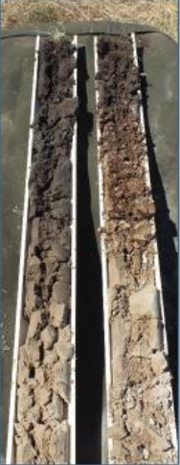
Soil Category =Soil Quality Limitations
Organic matter depletion-Management-induced depletion of any or all pools of soil organic matter resulting in limited soil function and processes that support plant productivity, biological activity, and water and nutrient cycling.
Notes:
Picture-These soil cores (taken 100 yards apart) show a comparison between the same soils with different management history. The left is native prairie, the right has been hayland for approximately 50 years.
Organic Matter Depletion-
Indicators-Soil cover, crusting, residue breakdown, soil color, water stable aggregates, soil structure, plant roots, biological diversity, and biopores
Causes:
• Soil disturbance (physical, chemical, and/or biological)
• Fallow (extended periods without living roots and crop canopy)
• Low crop biomass (surface and roots)
• Burning, harvesting, or otherwise removing crop and other plant residue
• Simplified crop rotations
Solutions:
• Cover crops (high residue)
• Diverse crop rotations with high residue crops
• No-till/strip-till cropping systems
• Nutrient management (reduce over application of nitrogen)
• Prescribed grazing
• Maintain evenly spread crop residues on the surface
• Well managed animal manure and compost applications
• Irrigation water management
• Drainage water management
• Mulching
• Reduced tillage
• Restoring plant communities and maintaining ecologically appropriate levels of litter and large woody debris

Slide 13
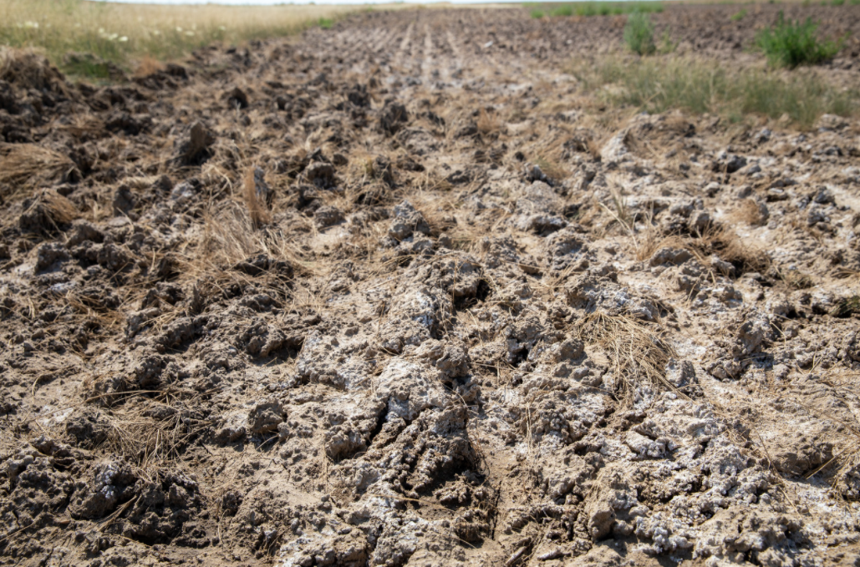
Soil Category =Soil Quality Limitations
Concentration of salts or other chemicals-Concentration of salts leading to salinity and/or sodicity reducing productivity or limiting desired use, or concentrations of other chemicals impacting productivity, populations of beneficial organisms, or limiting desired use.
Notes:
Concentration of salts or other chemicals
Indicators-White crusting of soil, irregular crop growth, and lack of plant vigor
Causes:
• Naturally occurring in soils with high concentrations of soluble salts, e.g., sodium, calcium, and magnesium sulfates
• Decreased infiltration
• Inadequate drainage to leach salt from the soil
• Upward migration of salt from shallow ground water
• Application of saline and/or sodic water
Solutions:
• Proper use of irrigation water
• Salt-tolerant crops
• Remove excess water from recharge areas
• Maintain the water table at safe levels
• Cropping and tillage systems that promote adequate infiltration and permeability
• Reduce deep tillage

Slide 14
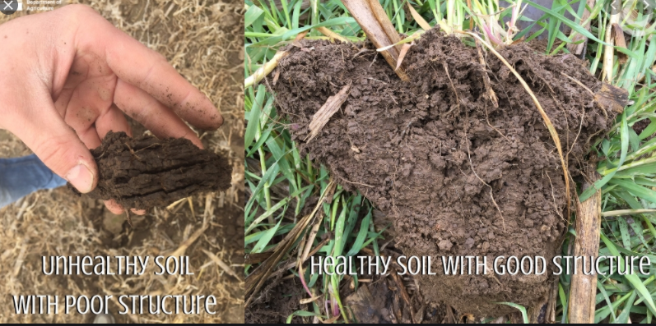
Soil Category =Soil Quality Limitations
Soil organism habitat loss or degradation-Quantity, quality, diversity, or connectivity of food, cover, space, shelter, and/or water is inadequate to meet the requirements of beneficial soil organisms.
Notes:
Soil organism habitat loss or degradation
Indicators: Soil cover, residue breakdown, water stable aggregates, soil structure, plant roots, biological diversity, and biopores
Causes:
• Soil disturbance
• Fallow
• Conventional tillage
• Low crop biomass (surface) and excessive crop biomass (surface)
• Burning, harvesting, or otherwise removing crop residue
• Simplified crop rotations
Solutions:
• Cover crops
• Diverse crop rotations
• No-till cropping systems
• Integrated pest management
• Nutrient management
• Prescribed grazing
• Maintain crop residues on the soil surface
• Well managed animal manure and compost applications
• Irrigation water management
• Mulching
• Conservation tillage

Slide 15
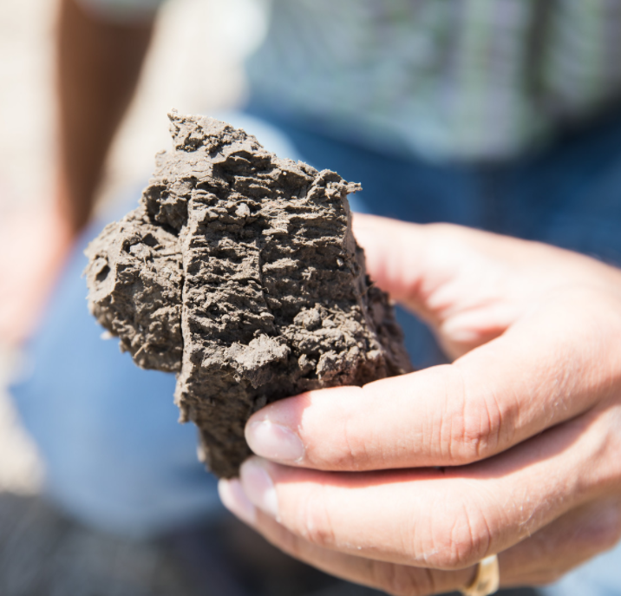
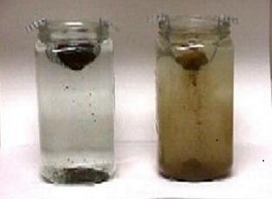
Soil Category =Soil Quality Limitations
Aggregate instability-Management-induced degradation of water stable soil aggregates resulting in destabilized soil carbon; surface crusting; reduced water infiltration, water holding capacity, and aeration; depressed resilience to extreme weather; increased ponding and flooding; increased soil erosion and plant stress; and reduced habitat and soil biological activity.
Notes:
Aggregate instability
Indicators-Soil cover, crusting, water stable aggregates, soil structure, plant roots, biological diversity, and biopores
Causes:
• Soil disturbance (physical, chemical, and/or biological)
• Monoculture cropping systems
• Fallow
• Low crop biomass (surface) and excessive crop biomass (surface)
• Burning harvesting or otherwise removing crop residue
• Simplified crop rotations
Solutions:
• Cover crops
• Diverse crop rotations that include high residue crops
• No-till/strip-till cropping systems
• Nutrient management
• Prescribed grazing
• Maintain evenly spread crop residues on the surface
• Well managed animal manure and compost applications
• Irrigation water management
• Drainage water management
• Mulching
• Reduced tillage
• Integrated pest management

Slide 16
Water
Category =Weather Resilience
Ponding and flooding-Water covering the land surface, along with saturated conditions below the surface, degrades natural resources, or restricts capability of land to support its intended use.
Seasonal high water table-Ground water or a perched water table causing saturated conditions near the surface degrades water resources or restricts capability of land to support its intended use.
Notes:
Ponding and Flooding
Indicators-Little to no established vegetation due to excess water, wet areas due to restrictive soil layers, flood prone buildings and structures
Causes:
• Decreased infiltration
• Ponding
• Stormwater runoff
• Flood prone areas
Solutions:
• Drainage management and structures for water control
• Roof runoff structures and capture for reuse methods
• Floodplain management
• Restore or enhance wetlands
• Windbreak placement for protection and to provide access
Seasonal High Water Table
Indicators-Public health and safety concerns related to drainage systems, property and structures exposed to shallow ground water flooding, hindered plant growth and with impacts to livestock production, impacts to farming practices that involve excavation and manipulation of storage of water
Causes:
• Water table becomes elevated due to precipitation rates, soil permeability, geological formations, drainage patterns, human impacts, and proximity to nearby surface water bodies
Solutions:
• Manage seasonal excess water with surface or subsurface drainage practices
• Implement wetland restorative and enhancing practices to promote wetland function, value, habitat, and diversity to pre-disturbance conditions

Slide 17
Water
Category =Weather Resilience
Seeps-Sub-surface saturated flows that percolates slowly to the surface, degrades water resources, or restricts capability of land to support its intended use.
Drifted snow-Wind-blown snow accumulates around and over surface structures, which restricts access to humans or animals; or wind removes snow from desired location where it can be used to accumulate water.
Naturally available moisture use-Natural precipitation is not optimally managed to support desired land use goals or ecological processes.
Notes:
Seeps
Indicators-Little to no established vegetation due to excess water, wet areas due to restrictive soil layers, flood prone buildings and structures
Causes:
• High water table
• Natural soil conditions
• Sub surface water due to prior development or land shaping
Solutions:
• Restore or enhance wetlands
• Wet meadow management
• Drainage management and structures for water control
• Tree Planting, windbreak placement for water use and to provide access
Drifted snow
Indicators-Cloudy or muddy water, stream/water body soil deposition
Causes:
• Blowing snow encounters barriers such as terrain, structures, and vegetation
• Snowdrifts form where the wind is slowed, typically in leeward positions
• Snowdrifts may be small or large depending on snowfall amounts, wind speed and direction, and configuration of barriers.
Solutions:
• Living snow fences of trees and shrubs, sometimes doubling as windbreaks or shelterbelts, designed and placed to protect animals and structures, provide access, limit runoff, and benefit soil moisture
• Snow fences or other structures configured to diminish effects of drifting snow
• Conservation tillage practices that retain crop stubble or rough surface conditions help to spread accumulation of drifted snow on crop land
Naturally available moisture use
Indicators-Soil erosion, poor plant growth
Causes:
• Clean or traditional tillage
• Unnaturally low organic matter
• Overgrazing of horses and livestock
Solutions:
• Use reduced/mulch tillage or no-till cropland strategies
• Increase soil organic matter by using cover crops, compost, and/or manure
• Reduce chemical inputs that kill naturally functioning organic components
• Manage grazing to optimize plant cover and regrowth to maintain roots for soil aggregation and improved water infiltration
• Drainage water management and tailwater recovery

Slide 18
Water
Category =Source Water Depletion
Surface water depletion-Water from collected precipitation runoff, ponds, lakes, surface watercourses and reservoirs is used at a rate that is detrimental to ecological functions or other identified uses and threatens sustained availability of surface water.
Groundwater depletion-Underground water is used at a rate greater than aquifer recharge.
Inefficient irrigation water use-Irrigation water is not stored, delivered, scheduled, and/or applied efficiently.
Notes:
Surface water depletion
Indicators-Decreased water levels of surface water bodies and ground water resources, increased withdrawal cost, deterioration of water quality, stressed vegetation and livestock, impact on neighboring water resources, degradation of wildlife habitat
Causes:
• The use of surface water at a rate greater than surface water body replenishment
• Drainage of surface water that negatively impacts wildlife habitat functions
Solutions:
• Manage surface water withdrawal rates to meet the client’s natural resource management and land use objectives while avoiding perpetuating existing natural resource concerns or creating new natural resource concerns
• Implement conservation practices that develop and replenish surface water resources, such as tailwater recovery irrigation systems and irrigation reservoirs
• Convert from lower efficiency to higher efficiency irrigation systems
• Decrease the baseline amount of water that crops require for growth by cultivating water-thrifty crops
• Restore surface water to wetlands and streams
Groundwater depletion:
Indicators-Well water levels decreased, water withdrawal cost, decreased water levels of surface water bodies, deterioration of water quality, land subsidence, stressed vegetation and livestock, impact on neighboring water resources
Causes:
• The use of ground water at a rate greater than aquifer recharge
Solutions:
• Manage ground water withdrawal rates to meet the client’s natural resource management and land use objectives while avoiding perpetuating existing natural resource concerns or creating new natural resource concerns
• Implement conservation practices that recharge ground water resources such as water harvesting catchment facilities and rain gardens
• Convert from lower efficiency to higher efficiency irrigation systems
• Irrigation tailwater recovery to reuse water
• Capture surface water with ponds and reservoirs
Inefficient irrigation water use
Indicators-Irrigated crops, plant stress, insufficient water supply
Causes:
• Open earthen ditches
• Irrigation water allowed to run off of fields
• Losses due to improper system design, installation, or maintenance
• Over irrigation causing excess deep percolation
• Untimely irrigation
• Irrigation resulting in degraded wildlife habitat
Solutions:
• Line ditches or install pipe; improve water transport systems
• Manage applications to reduce runoff; tailwater return systems
• Audit system and retrofit or replace where warranted

Slide 19
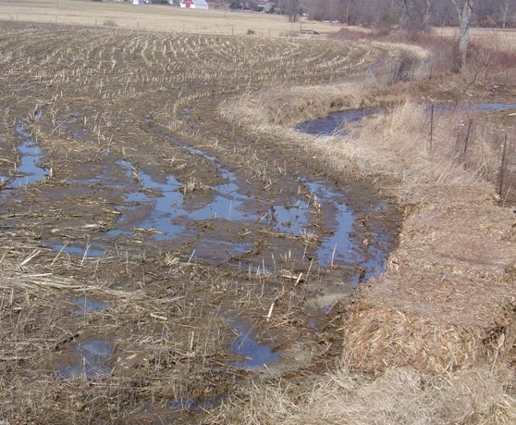
Water
Category =Field Sediment, Nutrient, and Pathogen Loss
Nutrients transported to surface water-Nutrients (organic and inorganic) stored, concentrated, or applied are transported to receiving surface waters in quantities that degrade water quality and limit its use for intended purposes.
Nutrients transported to groundwater-Nutrients (organic and inorganic) stored, concentrated, or applied are transported to ground waters in quantities that degrade water quality and limit its use for intended purposes.
Notes:
Nutrients transported to surface water
Indicators-Algae blooms, mass death of fish or aquatic organisms, dissolved oxygen concentrations, hypoxia
Causes:
• Overusing fertilizer (both residential and agricultural usage)
• Soluble nutrients
• Poor soil structure
• Decreased infiltration
• Conventional tillage
• Erosion of nutrient-laden soil
• Runoff from cropland, animal feeding operations and pastures, picking up nutrients and depositing them in water bodies
• Low nutrient holding capacity of soil
Solutions:
• Nutrient management planning to address the form, rate, placement, and timing of plant nutrient application
• Cover crops
• Crop rotations
• Conservation buffers and setbacks from surface water
• Residue management to improve the soil’s ability to retain nutrients
• Livestock production practices, such as feed management, animal waste storage, and handling animal mortality
• Drainage water management
• Irrigation water management
• Constructed wetlands
Nutrients transported to groundwater
Indicators-Algae blooms, mass death of fish or aquatic organisms, dissolved oxygen concentrations, hypoxia
Causes:
• Overusing fertilizer (both residential and agricultural usage)
• Soluble nutrients
• Runoff from cropland, animal feeding operations, and pastures, picking up nutrients and depositing them in water bodies and ground water access points
• Low nutrient holding capacity of soil
Solutions:
• Nutrient management to address the rate, source, placement, and timing of plant nutrient application
• Cover crops
• Crop rotations
• Conservation buffers and setbacks from sensitive areas
• Residue management to improve the soil’s ability to retain nutrients
• Livestock production practices, such as feed management, animal waste storage, and handling animal mortality
• Drainage water management
• Irrigation water management

Slide 20
Water
Category =Field Sediment, Nutrient, and Pathogen Loss
Pathogens and chemicals from manure, biosolids or compost applications transported to surface water and ground water-Pathogens, pharmaceuticals, leachate, and chemicals from manure, biosolids or compost transported to receiving waters in quantities that degrade water quality and limit uses.
Sediment transported to surface water-Offsite transport of sediment to surface water degrades water quality and limits use for intended purposes.
Notes:
Pathogens and chemicals from manure, biosolids or compost applications transported to surface/ground water
Indicators-Storage, handling, and application of manure, biosolids, or compost
Causes:
• Improper collection, handling, and storage of manure, biosolids, and compost
• Land application of infected manure, biosolids, or compost
• Improper disposal of dead animals
Solutions:
• Proper collection, handling, and storage system for agricultural waste
• Biological treatment (anaerobic storage, composting, anaerobic digesters)
• Vegetative filter strips, setbacks, and buffer zones
• Crop residue and tillage management
• Cover crops
• Manage livestock access to water
• Manage the rate, timing, and method of application of manure, biosolids, and compost
• Animal mortality management for routine
Sediment transported to surface water
Indicators-Cloudy or muddy water, stream/water body soil deposition
Causes:
• Bare or unprotected soil
• Long and steep slopes
• Intense rainfall or irrigation events when residue cover is at a minimum
• Decreased infiltration by compaction
Solutions:
• Residue management
• Crop rotations with high biomass crops
• Cover crops
• Strip cropping
• Terraces
• Grassed waterways and grade stabilization structures
• Buffers and filter strips to address the transport of sediment
• Windbreaks
• Streambank and shoreline protection

Slide 21
Water
Category =Field Pesticide Loss
Pesticides transported to surface water-Pesticides are lost from their application area and transported to surface water sources in quantities that degrade water quality and limit its use for intended purposes.
Pesticides transported to groundwater-Pesticide loses from the application area are transported to ground water sources in quantities that degrade water quality and limit its use for intended purposes.
Notes:
Pesticides transported to surface water
Indicators-Pesticide use in the farm/ranch operation
Causes:
• Pesticide use near sensitive waters
• Use of pesticides with intermediate or higher hazard rating and
• Where ground is cultivated
• With drift potential
• With impacts to beneficial organisms
Solutions:
• Integrated pest management strategies
• Prevention, avoidance, monitoring, etc.
• Timing, formulations, equipment, etc.
• Alternative pest suppression strategies
• Agrichemical handling facilities
• Vegetative buffers
• Residue management
• Cover crops
• Conservation crop rotation
• Drainage water management
• Proper use and storage
Pesticides transported to groundwater
Indicators-Pesticide use in the farm/ranch operation:
Causes:
• Pesticide use near sensitive waters
• Use of pesticides with intermediate or higher hazard risk
• In areas with leaching soils
• In aquifer recharge areas
Solutions:
• Integrated pest management strategies
• Prevention, avoidance, monitoring, etc.
• Timing, formulations, equipment, etc.
• Alternative pest suppression strategies
• Agrichemical handling facilities
• Vegetative buffers
• Residue management
• Cover crops
• Conservation crop rotation
• Drainage water management
• Proper use and storage

Slide 22
Water
Category =Storage and Handling of Pollutants
Nutrients transported to surface water-Nutrients (organic and inorganic) stored, concentrated, or applied are transported to receiving surface waters in quantities that degrade water quality and limit its use for intended purposes.
Nutrients transported to groundwater-Nutrients (organic and inorganic) stored, concentrated, or applied are transported to ground waters in quantities that degrade water quality and limit its use for intended purposes.
Notes:
*Covered under the category of Field Sediment, Nutrient and Pathogen Loss
Difference is that this is the storage and handling versus field application

Slide 23
Water
Category =Storage and Handling of Pollutants
Petroleum, heavy metals and other pollutants transported to surface water-Petroleum, heavy metals, and other chemical pollutants for onfarm use are lost from areas of concentration (handling, storage, or processing facilities and areas) to receiving surface waters in quantities that degrade water quality and limits its use for intended purposes.
Notes:
Petroleum, heavy metals and other pollutants transported to surface water
Indicators-Storage and handling of petroleum; use of biosludge, contaminated animal manure, and inorganic fertilizers
Causes:
• Inadequate storage and handling
• Repeated application of biosludge or inorganic fertilizers over a long period of time
• Unprotected surface water sources
Solutions:
• Proper storage and handling
• Petroleum and chemical containment systems
• Proper application, use, and monitoring of levels over time of biosludge and inorganic fertilizer
• Protect surface water sources
• Conservation buffers and application setbacks

Slide 24
Water
Category =Storage and Handling of Pollutants
Petroleum, heavy metals and other pollutants transported to ground water-Petroleum, heavy metals, and other chemical pollutants for onfarm use are lost from areas of concentration (handling, storage, or processing facilities and areas) to receiving ground water in quantities that degrade water quality and limit its use for intended purposes.
Notes:
Petroleum, heavy metals and other pollutants transported to ground water
Indicators-Storage and handling of petroleum; use of biosludge, contaminated animal manure, and inorganic fertilizers
Causes:
• Inadequate storage and handling
• Repeated application of biosludge or inorganic fertilizers over a long period of time
• Unprotected ground water sources
Solutions:
• Proper storage and handling
• Petroleum and chemical containment systems
• Proper application, use, and monitoring of levels over time of biosludge and inorganic fertilizer
• Protect surface water sources
• Conservation buffers and application setbacks

Slide 25
Water
Category =Salt losses to water
Salts transported to surface water-Irrigation or rainfall runoff transports salts to receiving surface waters in quantities that degrade water quality and limit use for intended purposes.
Salts transported to groundwater-Irrigation or rainfall infiltration transports salts to ground water in quantities that degrade water quality and limit use for intended purposes.
Notes:
Salts transported to surface water
Indicators-White crusting of soil, irregular crop growth, and lack of plant vigor
Causes:
• Naturally occurring in soils with concentrations of soluble salts, such as sulfates of sodium, calcium, and magnesium in the soil
• Inadequate drainage to leach salt from the soil
• Upward migration of salt from shallow ground water
• Application of saline water
Solutions:
• Proper use of irrigation water
• Salt-tolerant crops
• Remove excess water from recharge areas
• Maintain water table at a safe levels
• Cropping and tillage systems that promote adequate infiltration and permeability
• Reduce deep tillage
Salts transported to ground water
Indicators-White crusting of soil, irregular crop growth, and lack of plant vigor
Causes:
• Naturally occurring in soils with concentrations of soluble salts, such as sulfates of sodium, calcium, and magnesium in the soil
• Inadequate drainage to leach salt from the soil
• Upward migration of salt from shallow ground water
• Application of saline water
Solutions:
• Proper use of irrigation water
• Salt-tolerant crops
• Remove excess water from recharge areas
• Maintain water table at a safe levels
• Cropping and tillage systems that promote adequate infiltration and permeability
• Reduce deep tillage

Slide 26
Air
Category =Air Quality Emissions
Emissions of particulate matter (PM) and PM precursors -Direct emissions of particulate matter (PM)—dust and smoke—as well as the formation of fine particulate matter in the atmosphere from other agricultural emissions—ammonia, oxides of nitrogen (NOx), and volatile organic compounds (VOCs)—can cause multiple negative environmental impacts.
Emissions of greenhouse gases-GHGs-Emissions of methane (CH4), nitrous oxide (N2O), and carbon dioxide (CO2) increase atmospheric concentrations of greenhouse gases.
Notes:
Emissions of Particulate Matter and Particulate Matter Precursors
Indicators-Dust, smoke, chemical and fertilizer use, animal activities
Causes:
• Combustion (engines, burning)
• Chemical pesticide drift
• Nitrogen application
• Field operations (tillage, harvesting, etc.)
• Unpaved roads
• Windblown dust
• Confinement-based animal operations
Solutions:
• Smoke management, ensure good combustion for applied fires
• Proper engine/combustion unit maintenance and operation
• Engine/combustion unit replacement and retrofit
• Windbreaks or other wind barriers
• Reduce travel/speed and treat unpaved roads
• Residue management, conservation tillage, maintaining vegetative cover
• Open lot manure harvesting and sprinkler systems
• Air filtration on enclosed manure storages and animal housing
Emissions of Greenhouse Gases
Indicators-Greenhouse gas emissions
Causes:
• Nitrogen application
• Conventional tillage
• Loss of carbon stocks from soils and biomass
• CH4 production from animal operations
Solutions:
• Apply nitrogen using the 4Rs
• Conservation tillage and reduced soil disturbance
• Maintain undrained hydric and organic soils with perennial cover
• Feed management to reduce enteric methane emissions
• Proper manure management
• Use covers in manure management systems to capture and even reuse produced biogas

Slide 27
Air
Category =Air Quality Emissions
Emissions of ozone precursors-Emissions of ozone precursors—oxides of nitrogen (NOx) and volatile organic compounds (VOCs)—result in formation of ground-level ozone, which can have negative impacts to human, plant, and animal health.
Objectionable odor-Emissions of odorous compounds—volatile organic compounds (VOCs), ammonia, and odorous sulfur compounds—can cause nuisance conditions.
Notes:
Emissions of Ozone Precursors
Indicators-Engines, pesticides, burning, tillage, and animal operations
Causes:
• Combustion (engines, burning)
• Animal operations
• Pesticide application
Solutions:
• Smoke management, ensure good combustion for applied fires
• Proper engine/combustion unit maintenance and operation
• Engine/combustion unit replacement and retrofit
• Integrated pest management
• Feed and manure management
• Comprehensive nutrient management planning
• Air filtration on enclosed manure storages and animal housing
Objectionable Odor
Indicators-Manure storage facilities, animal housing, manure and land application
Causes:
• Confined animal areas
• Manure and fertilizer application
• Pesticide application
Solutions:
• Feed management to reduce excess sulfur and nitrogen inputs to animal systems
• Air filtration of enclosed manure storages and animal housing
• Manure management techniques to minimize, recover, or control emitted gases
• Moisture management to control dust and odors associated with livestock confinement areas
• Proper nutrient management and application
• Windbreaks

Slide 28
Air
Category =Air Quality Emissions
Emissions of airborne reactive nitrogen-Emissions of airborne reactive nitrogen—ammonia and oxides of nitrogen—can negatively impact atmospheric chemistry, cause unwanted fertilization via deposition in sensitive ecosystems, and degrade regional visibility.
Notes:
Emissions of Airborne Reactive Nitrogen
Indicators-Fertilizer application, burning, engines, and animal operations
Causes:
• Nitrogen application
• Combustion (engines, burning)
• Animal operations
Solutions:
• Apply nitrogen using the 4Rs
• Smoke management, ensure good combustion for applied fires
• Proper engine/combustion unit maintenance and operation
• Engine/combustion unit replacement and retrofit
• Feed management for nitrogen-based nutrients
• Proper manure management

Slide 29
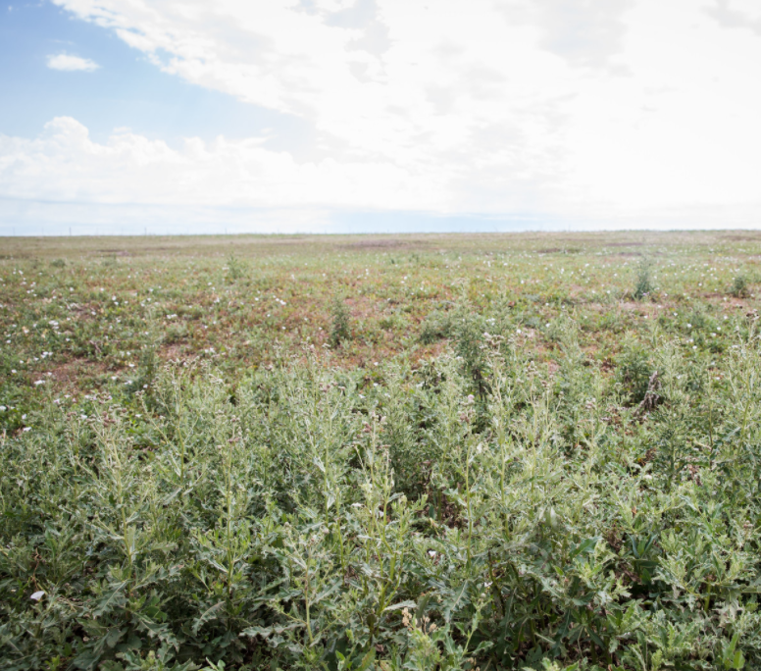
Plants Category=Plant Pest Pressure
Plant pest pressure-Excessive damage to plant communities from pests such as undesired plants, insects, diseases, animals, soil borne pathogens, and nematodes. This concern addresses invasive plant, animal and insect species.
Notes:
Plant Pest Pressure
Indicators-Animal, insect, and/or disease damage, or competition from common weeds or invasive plants substantially reduces yield, growth, or desired plant community composition or structure
Causes:
• Plants suffer from attacks by pests or disease
• Weeds or invasive plants outcompete desired crop or desired plant community
• Plants are weak or not thriving
Solutions:
• Use integrated pest management to employ early detection, avoidance, and treatment of pests
• Consider brush management, vegetative weed control, mulching, or prescribed grazing or burning
• Use plants adapted to climate and soils
• Use of local, source-identified seed of native species when available

Slide 30
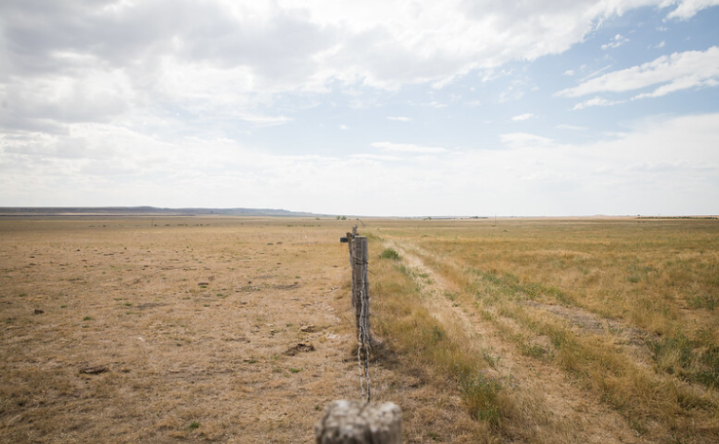
Plants Category=Degraded Plant Condition
Plant productivity and health-Improper fertility, management, or plants not adapted to site negatively impact plant productivity, vigor, and/or quality.
Notes:
Plant productivity and health-
Indicators-Yield or growth is substantially less than expected, plants are disease and/or pest-ridden, plants fail to thrive
Causes:
• Plants receive inadequate nutrition during critical growth periods
• Plants fail to thrive due to poor soil conditions
• Plants wilt, freeze or rot even during normal climate conditions
• Plants not adapted to site
• Plants are grazed or harvested below adequate stubble heights for adequate energy reserves
• Plant community not resistant or resilient to natural or cultural stressors
• Plant community management using inappropriate methods, timing, extent, duration, or frequency
Solutions:
• Use nutrient management to address the form, rate, placement, and timing of nutrient application
• Consider crop rotations, deep rooted cover crops, drainage, and deep tillage
• Consider alternate crops/trees or different plant varieties
• Manage grazing periods to alter timing frequency, duration during seasonal growth variations
• Manage harvest heights and timing to increase plant vigor and production yields
• Improve plant community diversity and structure to restore and maintain plant community health and productivity
• Use site-suited, genetically appropriate plant materials
• Implement management practices to achieve desired plant community composition, structure, and productivity to maintain ecosystem health
• Use appropriate timing, duration, and extent, and frequency of management practices to achieve desired productivity and health outcomes

Slide 31
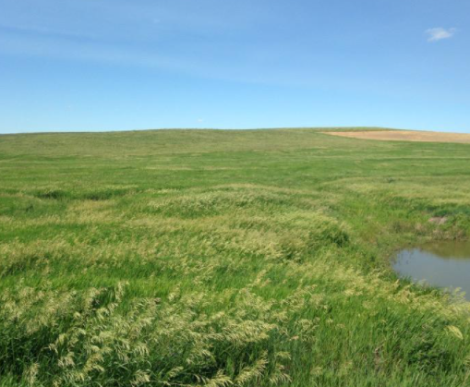
Plants Category=Degraded Plant Condition
Plant structure and composition-Plant communities have insufficient composition and structure to achieve ecological functions and management objectives. This resource concern includes degradation of wetland habitat, targeted ecosystems, or unique plant communities.
Notes:
Plant Structure and Composition-
Causes:
• Pests, disease, fire exclusion, wildfire, and/or mismanagement reduces or eliminates key components of the plant community
• Invasive species outcompete desired plants
• Loss of or change in natural disturbance regimes (e.g., fire, wind, flooding, weather patterns)
Solutions:
• Employ or modify use of cultural practices (e.g., grazing, burning, mowing, pruning)
• Treat or remove vegetation to reestablish desired habitat
• Control invasive species and use integrated pest management techniques to maintain the plant community
• Reestablish desired plant community

Slide 32
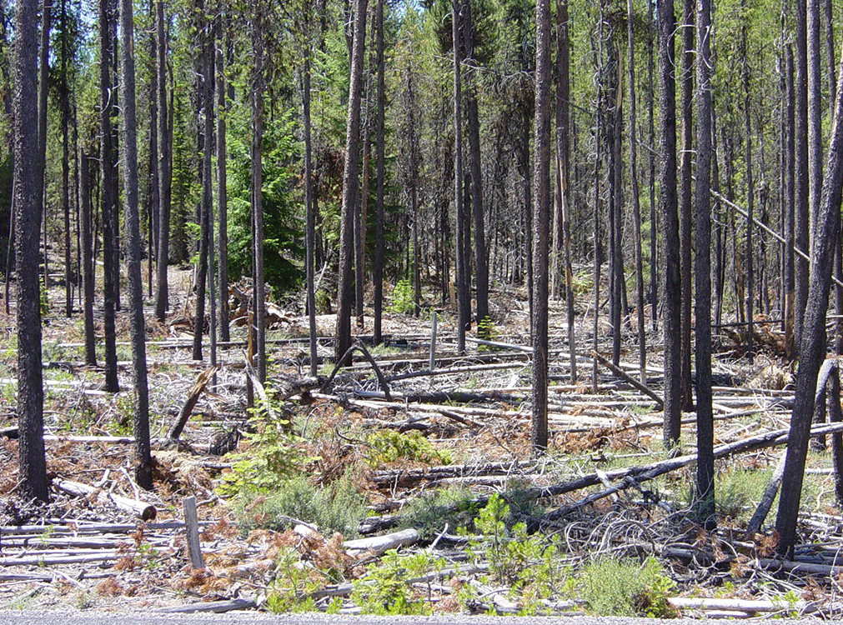
Plants Category-Fire Management
Wildfire hazard from biomass accumulation-The kinds and amounts of plant biomass create wildfire hazards that pose risks to human safety, structures, plants, animals, and air resources.
Notes:
Wildfire hazard from biomass accumulation
Indicators-Excess biomass, biomass distribution, lack of preparedness
Causes:
• Overstocked forest increases the risk of fire outbreak
• Continuous fuels increases the risk of the spread of fire
• Abundance of ladder fuels increase fire intensity and potential rate of spread
• Lack of planning on how to respond to fire increases risk to life and property
• Excessive fuel loads that may pose a significant risk to the desired plant community composition and structure if inappropriate burn prescriptions are planned
Solutions:
• Thin excess trees and brush
• Reduce ladder fuels
• Treat or remove vegetation, debris, and detritus
• Implement management in wildland urban interface (WUI) areas
• Create and implement a wildfire plan:
• Post fire control agency phone numbers
• Locate and map water sources
• Map out evacuation routes
• Equip vehicles with fire fighting tools
• Adapt and finely hone burn prescriptions to address excessive fuel loads that may negatively impact desired plant conditions during a burn

Slide 33
Animals
Category =Livestock Production Limitation
Feed and forage balance-Feed and forage quality or quantity is inadequate for nutritional needs and production goals of the kinds and classes of livestock.
Inadequate livestock water quantity, quality, and distribution-Quantity and quality of drinking water are insufficient to meet basic needs for the kind and class of livestock and improper distribution negatively impacts other resources.
Notes:
Feed and forage balance
Indicators-Feed and forage not adequate to support the livestock operation
Causes:
• Insufficient forage and livestock feed
• Overstocking of livestock
• Inadequate distribution of livestock grazing
• Poor feed quality
• Weed, insect, or disease problems
Solutions:
• Prescribed grazing systems
• Adequate water distribution
• Production of high quality feed and forage
• Forage analysis for nutrient quantity and quality
Inadequate livestock water quantity, quality, and distribution
Indicators-Lack of water, poor water quality, poor distribution can affect livestock health
Causes:
• Water availability is limited
• Water quality is compromised
• Spring area trampled by livestock
• Livestock in wetland, stream, or pond creating potential health concerns
Solutions:
• Inventory, evaluate, and plan watering system for livestock type
• Use pipelines and watering facilities to increase water distribution across the grazing system
• Establish select watering points and construct watering facilities to move livestock away from streams and ponds

Slide 34
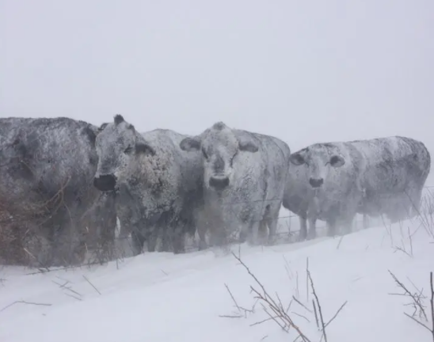
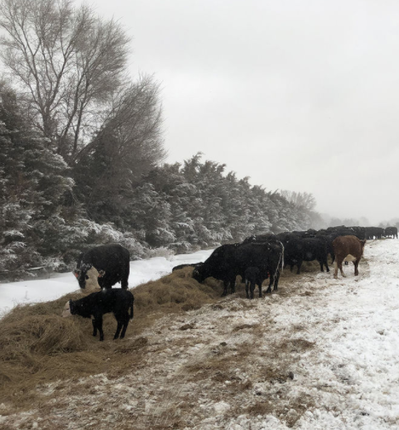
Animals Category-Inadequate Livestock Shelter
Inadequate livestock shelter-Livestock lack adequate shelter from climatic conditions to meet basic needs.
Notes:
Inadequate livestock shelter
Indicators-Vegetative, landscape, and/or structural options for livestock shelter do not exist; livestock are exposed to severe climatic conditions
Causes:
• Exposure to extreme wind and cold in system that supports tree growth
• Historical shelterbelt is partially functioning
• Exposure to extreme wind, cold and heat in area where plant options are limited or temporary shelter is preferred
Solutions:
• Permanent windbreak establishment using native or naturally occurring plant materials
• Renovate partially existing shelter belt
• Permanent or portable livestock shelter structure

Slide 35
Animals
Category =Terrestrial habitat
Terrestrial habitat for wildlife and invertebrates-Quantity, quality or connectivity of food, cover, space, shelter, and/or water is inadequate to meet requirements of identified terrestrial wildlife or invertebrate species.
Notes:
Terrestrial habitat for wildlife and invertebrates
Indicators-Loss of habitat to support desired wildlife species
Causes:
• Insufficient shelter/cover
• Insufficient food
• Insufficient water quantity or quality
• Fragmented habitat
Solutions:
• Add shelter features, such as nest boxes or platforms, brush piles, rock piles, and root wads
• Leave portions of crop fields unharvested
• Create or restore wetlands and ephemeral water features
• Add herbaceous buffers and tree or shrub plantings, such as shelterbelts, hedgerows, windbreaks, and similar plant structures

Slide 36
Animals
Category =Aquatic habitat
Aquatic habitat for fish and other organisms-Habitat requirements of identified fish and other organisms are inadequate.
Elevated water temperature-Surface water temperatures exceed State/Federal standards in downstream receiving waters which limits its use for intended purposes.
Notes:
Aquatic habitat for fish and other organisms
Indicators-Loss of habitat to support desired wildlife species
Causes:
• Lack of structure and cover for aquatic organisms
• Insufficient water quantity or quality
• Barriers to movement
• Duration, timing, and connectivity with floodplain and off-channel habitats
• Lack of instream complexity (pools, riffles, detritus, wood, etc.)
• Water temperature
Solutions:
• Restore and enhance water bodies, instream and floodplain wood placement, reestablish native species
• Maintain or expand herbaceous or tree and shrub buffers and ephemeral water bodies
• Replace culverts to remove restrictions to movement of aquatic species
• Restore wetlands
• Restore instream and floodplain connectivity
• Restore instream complexity, such as for sinuosity, pools, riffles, the channel, and bank stability
• Restore water quality
Elevated Water Temperature
Indicators-Water temperature exceeds legal standard, threatens the health of aquatic organisms, or limits the intended use by the client
Causes:
• Surface water unprotected from direct sunlight
• Little or no ground water contribution to water body
• Sediment laden runoff reaching water body
Solutions:
• Reestablish riparian vegetation
• Brush management and residue management
• Terraces and water and sediment control basins
• Grassed waterways and grade stabilization structures
• Buffers and filter strips
• Streambank and shoreline protection

Slide 37
Energy
Category =Inefficient Energy Use
Energy efficiency of equipment and facilities-Stationary equipment and facilities are using energy inefficiently.
Energy efficiency of farming/ranching practices and field operations-Mobile onfarm, ranching, forestry, or field operations are using energy inefficiently.
Notes:
Energy efficiency of equipment and facilities
Indicators-High Energy Costs
Causes:
• Unvented, propane-fired heated systems
• Throttling valves to control water flow
• Using incandescent or T12 lights
• Heat loss from building
• Inefficient pumps
Solutions:
• Convert to a more energy efficient heat source such as radiant heating
• Convert to variable displacement pump
• Replace with LED or T8 lighting
• Install air barrier system and insulation
• Replace with high efficiency pumps
Energy efficiency of farming/ranching practices and field operations
Indicators-High Energy Costs
Causes:
• Unnecessary trips across the field
• Application of commercial fertilizer
• Excessive insecticides
Solutions:
• Convert to minimum or no-till
• Plant nitrogen-fixing legumes
• Implement a Pest Management System

Slide 38
Human
Category =Long Term Protection of Land
Threat of conversion
Loss of functions and values
Notes:
Human Considerations
Conservation path forward that addresses the identified resource concerns and works well for the client
Causes:
• Resource concerns impacting the farm or ranch operation and the environment
• Pressures from development and landuse changes
Solutions:
• Conservation plans and easements
• Listen to the client and present the evaluations in a manner easily understood by the stakeholders
• A description of the resource setting
• A description of the management system
• A complete list of the type, amount, and timing of actions involved in the management system that may change as a result of the plan
• Effects of the actions on the resources and human considerations

Slide 39
Questions?
Contact: Jessica.Michalski@usda.gov (605) 880-5670

